Slide 1

ADS PROJECT P19-EQUANS-P2
TITLE: Bouygues Company Travel Analytics:
Navigating Sustainable Travel Paths using Scope 3 Emissions Data.
Industry partner: BYES Contracting/ EQUANS Data Centres
TEAM MEMBERS:
11358614, 10561583, 11309069, 11311800, 11484267

Slide 2
Objectives
Carbon footprint assessment: Evaluate the environmental impacts of company travel by analysing carbon emissions associated with different modes of company transportation and accommodation.
Optimisation of routes: Identify and suggest sustainable routes and transportation options to reduce overall environmental impact.
Public transport Usage: Analyse data to understand the use of public transportation, identifying areas where it can be improved for better environmental outcomes.
Traffic pattern analysis: Examine travel data to understand peak travel times and locations.
3. Sustainability in accommodation: Assess associated emissions and practices of company accommodation in the travel data and recommend more sustainable options e.g. leading sustainable accommodation per location (lowest relating emissions).
4. Behavioural analysis: Understand traveller behaviour to develop strategies that promote sustainable choices and practices during travel.
Notes:
Outcomes:
Overview of the environmental impact of company travel.
Analysis and identification of optimal transportation routes.
Analysis and identification of sustainable accommodation choices.
Recommendation for sustainable transport strategies based on analysis of travel behaviours.
Data files provided:
Egencia Air Ticket Data: January 2020 to January 2024
Egencia Train Ticket Data: January 2020 to January 2024
Egencia Hotel Data: January 2020 to January 2024
Egencia Car Hire Data: January 2020 to January 2024
Detailed Project Description: This project is focussed around company travel (for business purposes) which falls within scope 3 of environmental emissions reporting.
Data has been extracted from Egencia – the company travel platform, through which all company travel is booked and tracked.
This project aims to utilise this data to gain insight into company travel patterns and to provide recommendations for strategies aimed at reducing the impacts of company travel.

Slide 3
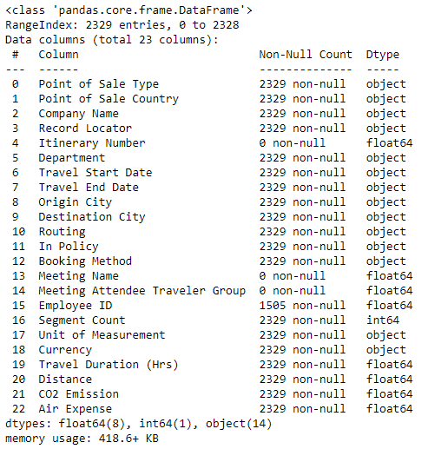
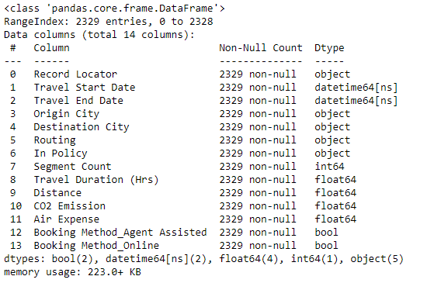
Preprocessing – Airplane Data
We preprocessed the plane data to get it to a point where we can interpret it
Before
After
Remove fields:
Null values
Remove fields:
Only takes
one value
One hot encoded

Slide 4
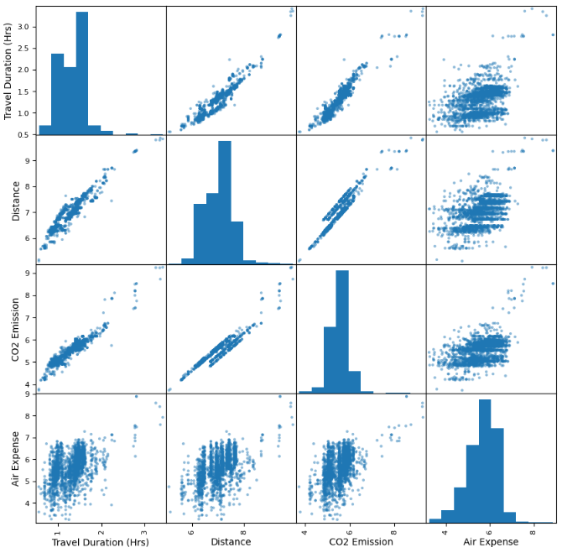
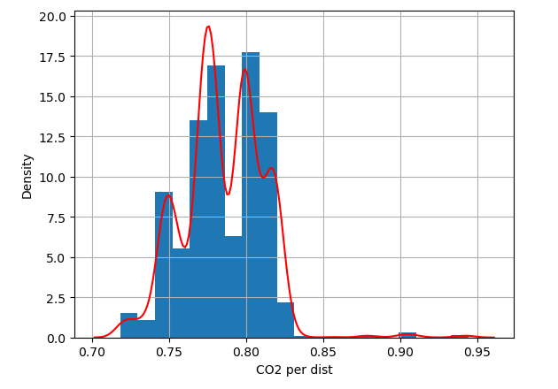
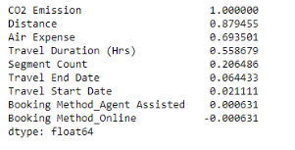
Carbon Footprint Assessment – Airplane Data​​
We can use the data to calculate the CO2 per distance
Firstly, we found the variables that were most correlated with the CO2 emission.
After a logarithmic transform, we get the following scatter plots:
We end up getting around 0.2233kg CO2 emissions per km on average.

Slide 5
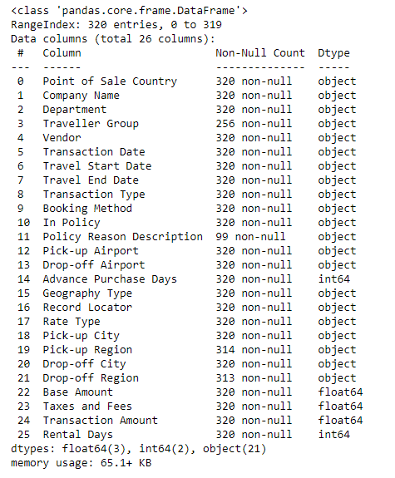
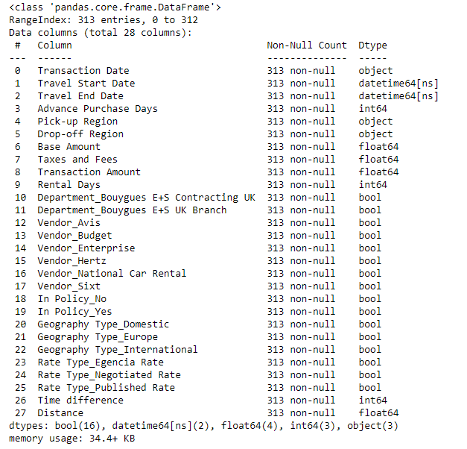
Preprocessing – Car Data
We do similar preprocessing with the car data
Deleted records
with null values
After
Converted to DateTime
Before
Remove fields:
Only takes
Limited values
Remove field:
Null values
One hot encoded
New fields

Slide 6
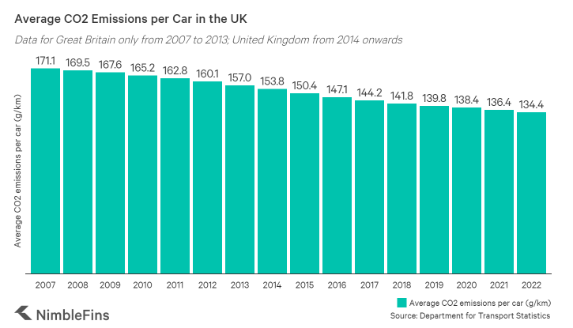
Carbon Footprint Assessment – Car Data​
Unfortunately, the car data did not have a lot of information to use when calculating the average carbon emissions per distance.
We attempted to use rough distances of the regions/cities listed but it was too approximate.
We instead used the average CO2 emissions per car in the UK in 2022 which was 0.1344kg CO2 emissions per km.

Slide 7
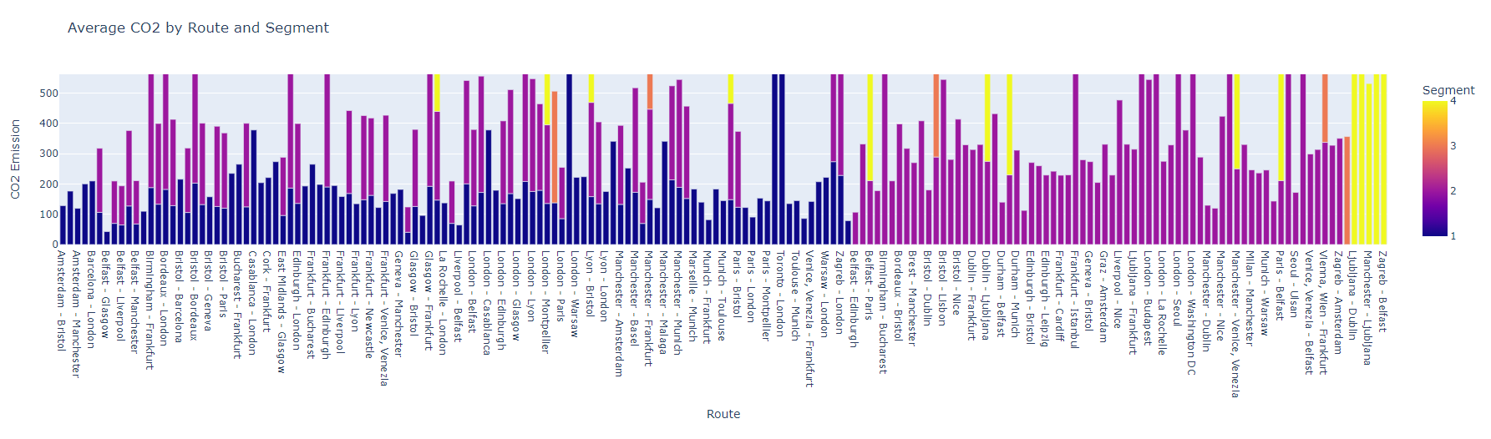
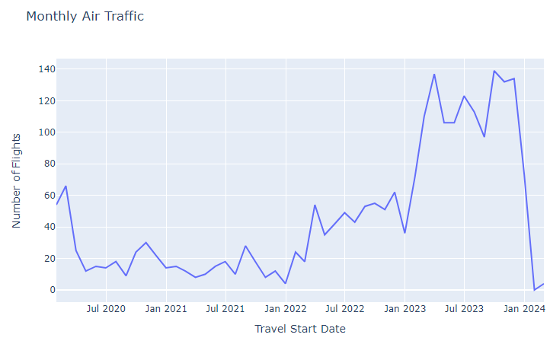
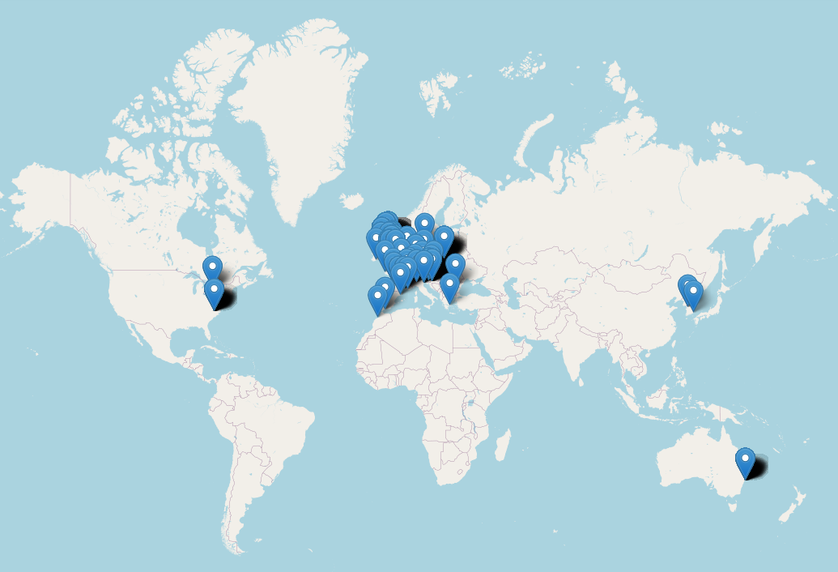
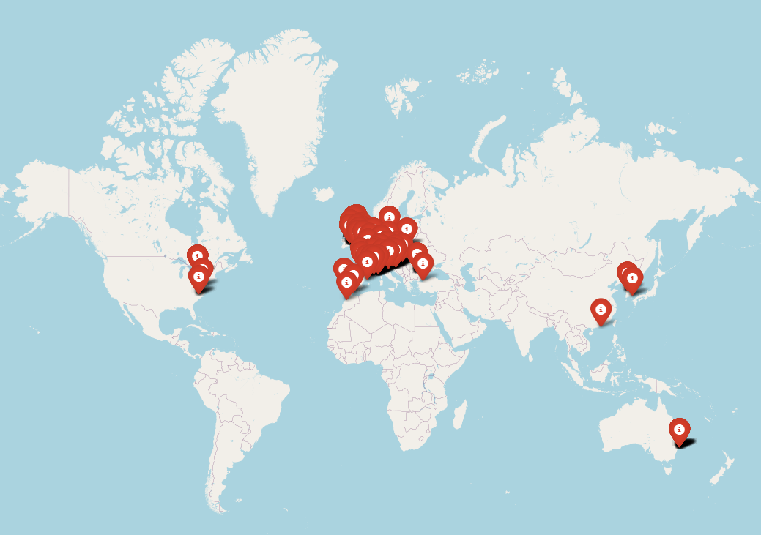
Traffic Analysis - Airplane Data
Monthly Air Traffic Analysis
Origin cities geolocation map showing traffic.
Destination cities geolocation map showing traffic.
The traffic analysis reveals air travel patterns crucial to the company’s operations, focusing on major locations across the United Kingdom and Europe. Manchester, London, Edinburgh, Frankfurt, and Glasgow emerge as key hubs driving business activities, evident in the most frequented routes. Concurrently, our destination analysis revels a global footprint, with significant business engagement extending to Australia, Canada, USA, and Japan.
Notes:
The approach to arrive these results utilized a combination of tools and libraries in Python, pandas for data analysis, folium for creating maps and ARCGIS geocoder from geopy library which converted the city names to coordinates. Identified major traffic hotspots for business activities, with significant travel volumes observed in the United Kingdom and Europe. This indicates key regions of business engagement and potential areas for further optimization.
The frequency of flights has increased from 2020 to 2024.
Majority of flights are for segment 1 and 2. As per the analysis, as the segments increase, CO2 emissions increases. Direct flights is the solution to save amount of Co2.

Slide 8
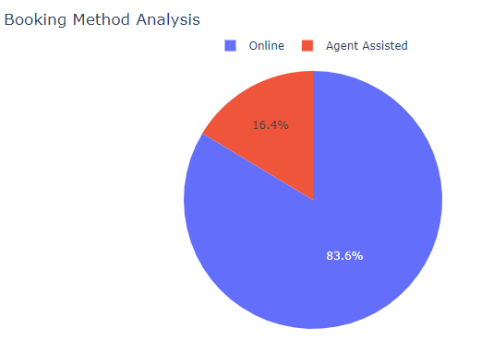
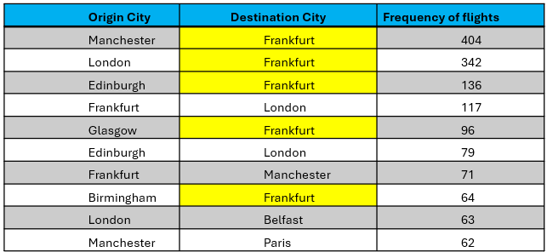
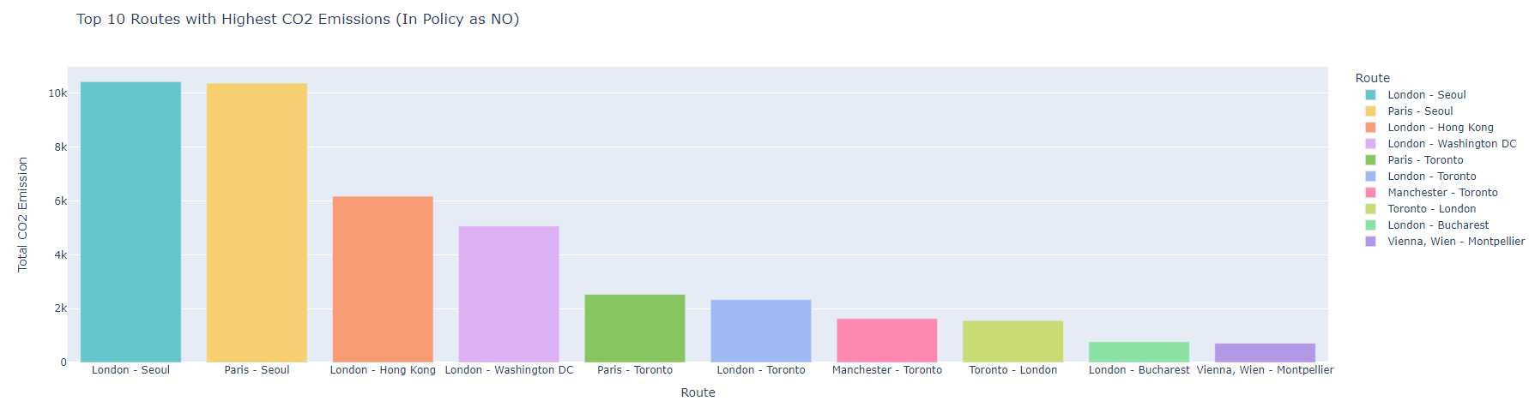
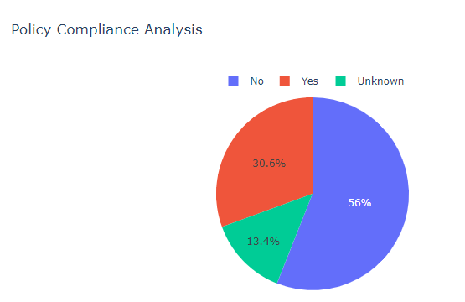
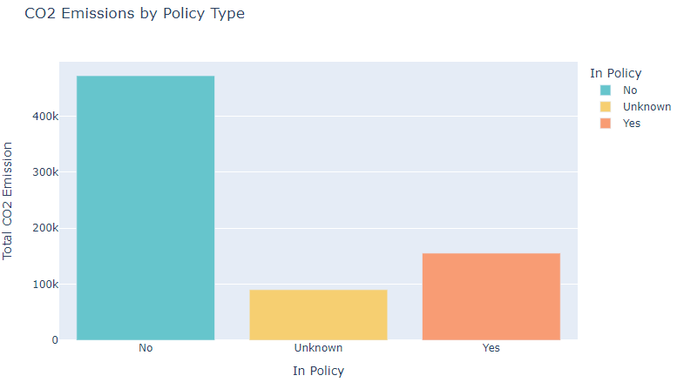
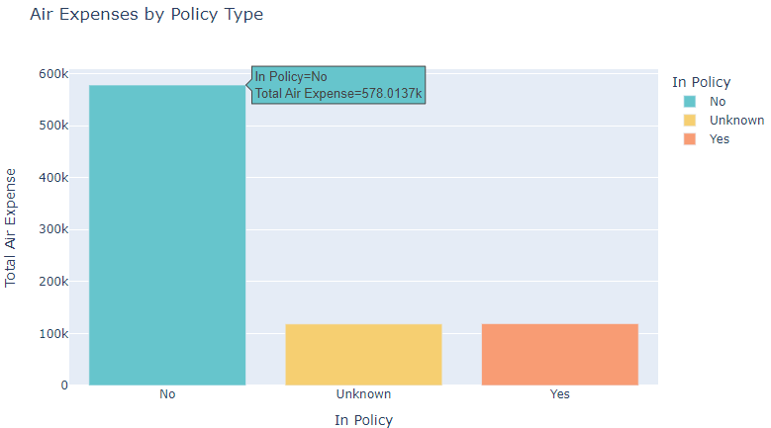
Behaviour Analysis – Airplane Data
Top 10 travelling routes of employees
Majority of employees trust online booking for airplane tickets.
More than 50% of flight bookings are not following the booking policy of the company which results in more carbon emissions and air expenses as shown in the bar chart.

Slide 9
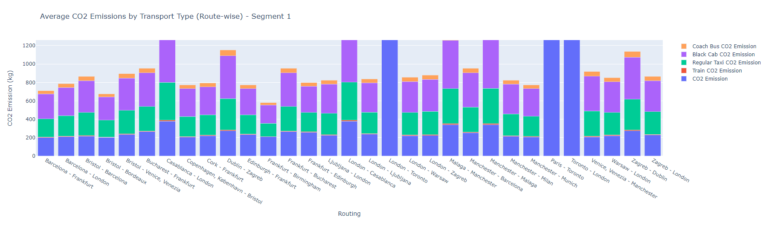
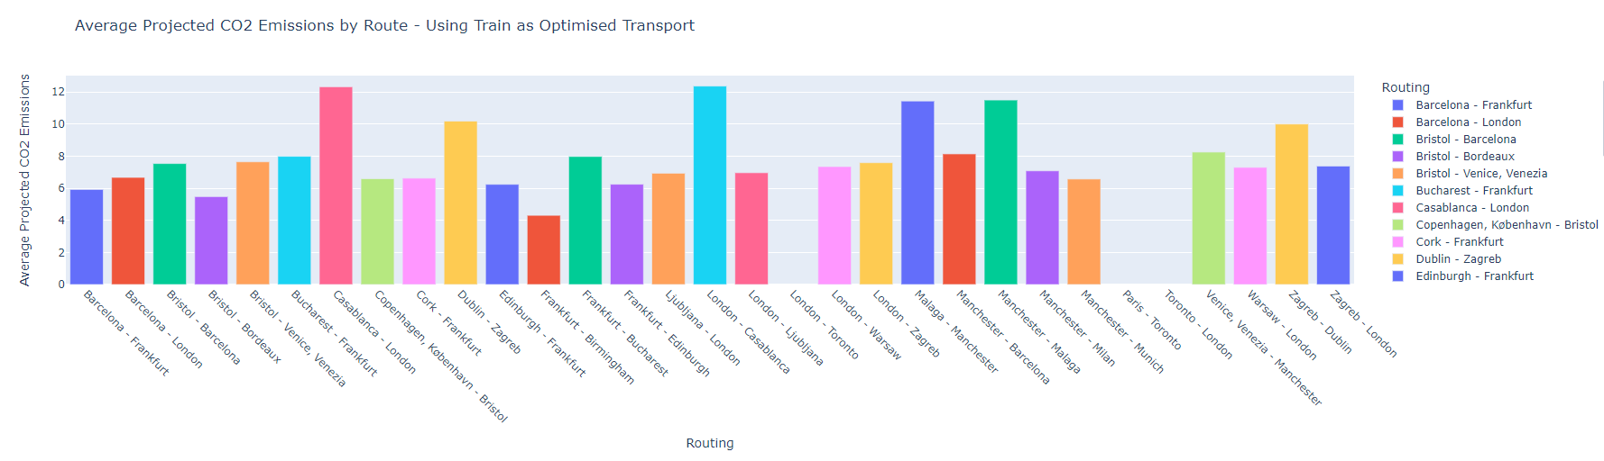
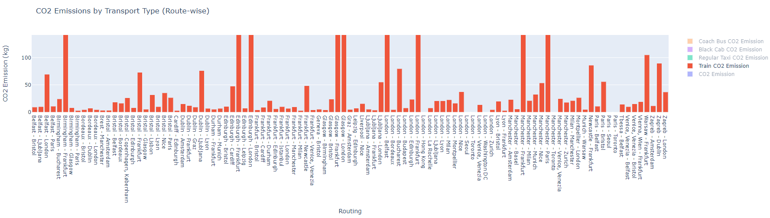
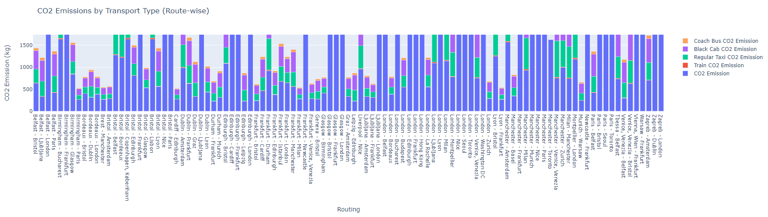
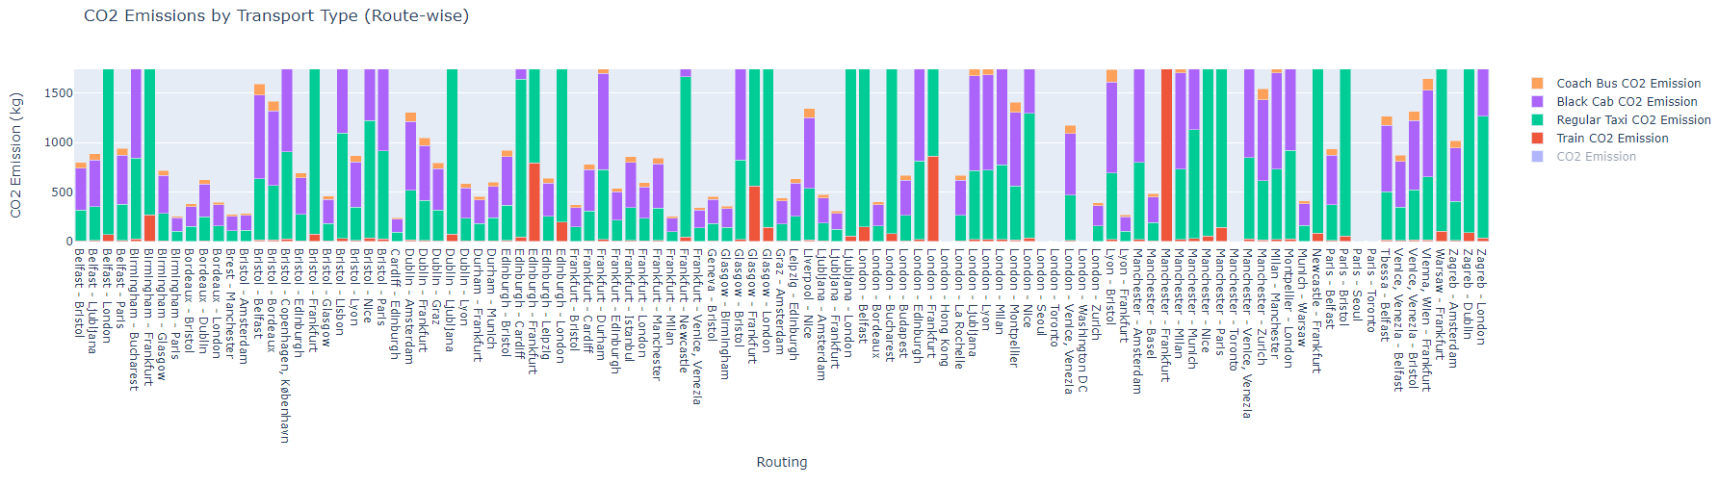
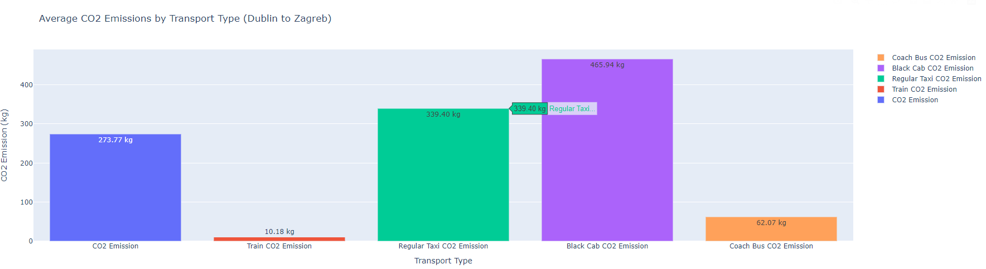
Optimisation of Routes and Public Transport Usage
Initial filtering and column selection for relevant flight data and environmental metrics.
Filtering of the resulting dataframe to include only rows where CO2 emissions exceed 200 kg/km for significant environmental impact flights.
Integration of Google Maps Distance Matrix API for computation of road distances between origin and destination cities.
Geocoding of city names to provide country information for classification of rail travel types.
Calculation of CO2 emissions for rail travel and other transport modes using predefined emission factors per kilometer.
Additional functions to calculate CO2 emissions for taxis, black cabs, and buses based on computed distances from the API.
Segment - 2
Notes:
After examining and analysing the data I divided my data in to 2 parts: segment 1 and segment 2 flights.
after removing the co2 emissions and comparing the other transports based on emission we can see that taxi and cab is domination the chart which infers that taxis/cabs are not a viable choice of option for travelling between these routes.
When we remove all the filters and just focus on the train emission on the y-axis, we can see that CO2 values have dropped from more than 1500 to less than 100 now which concludes my analysis that we can actually save 98% of CO2 emission by choosing train above all.

Slide 10
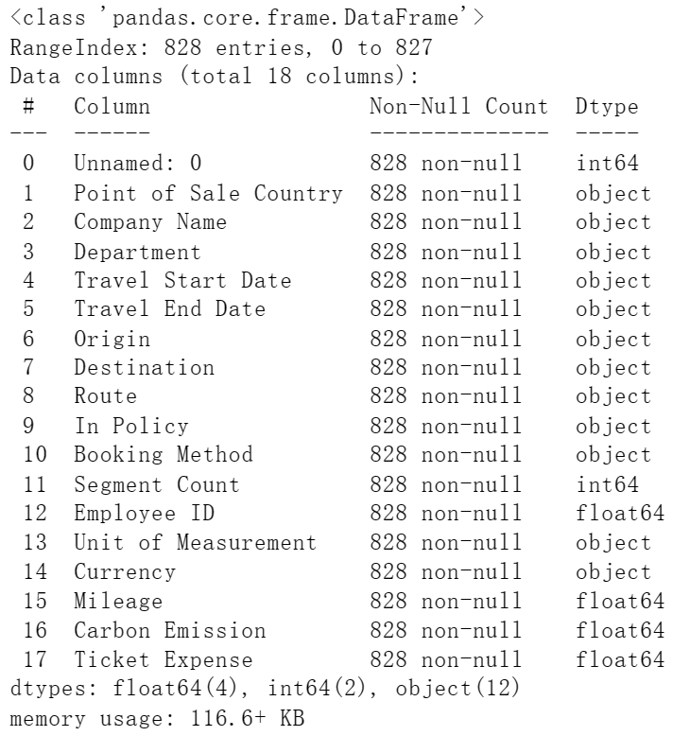
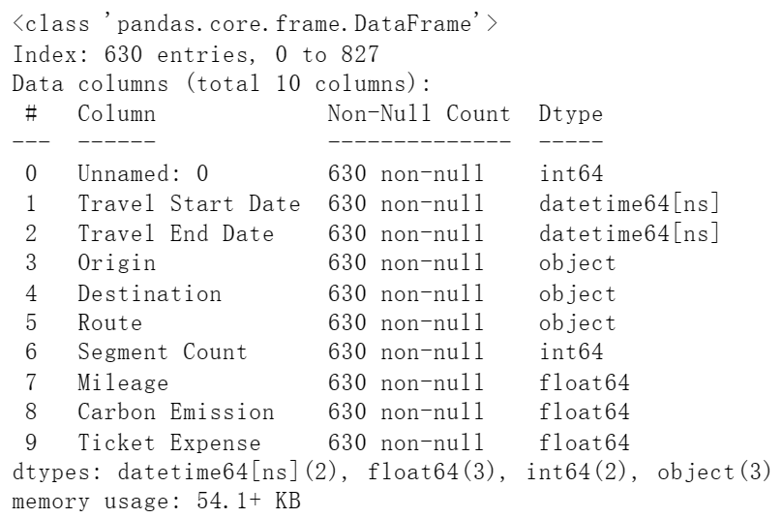
Preprocessing – Train Data​​​
We preprocessed the train data to get it to a point where only valued data left:
Before
After
Converted to DateTime
Remove part:
Origin = Destination
Remove fields:
Only takes
limited value
Deleted records
with null values

Slide 11
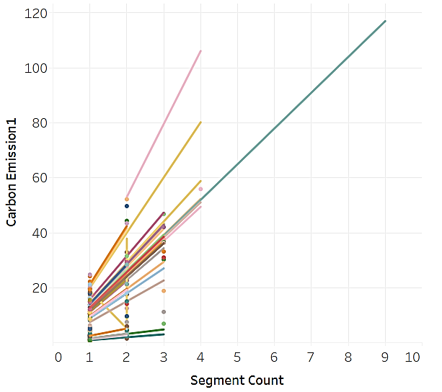
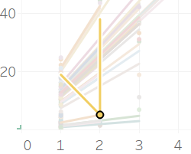
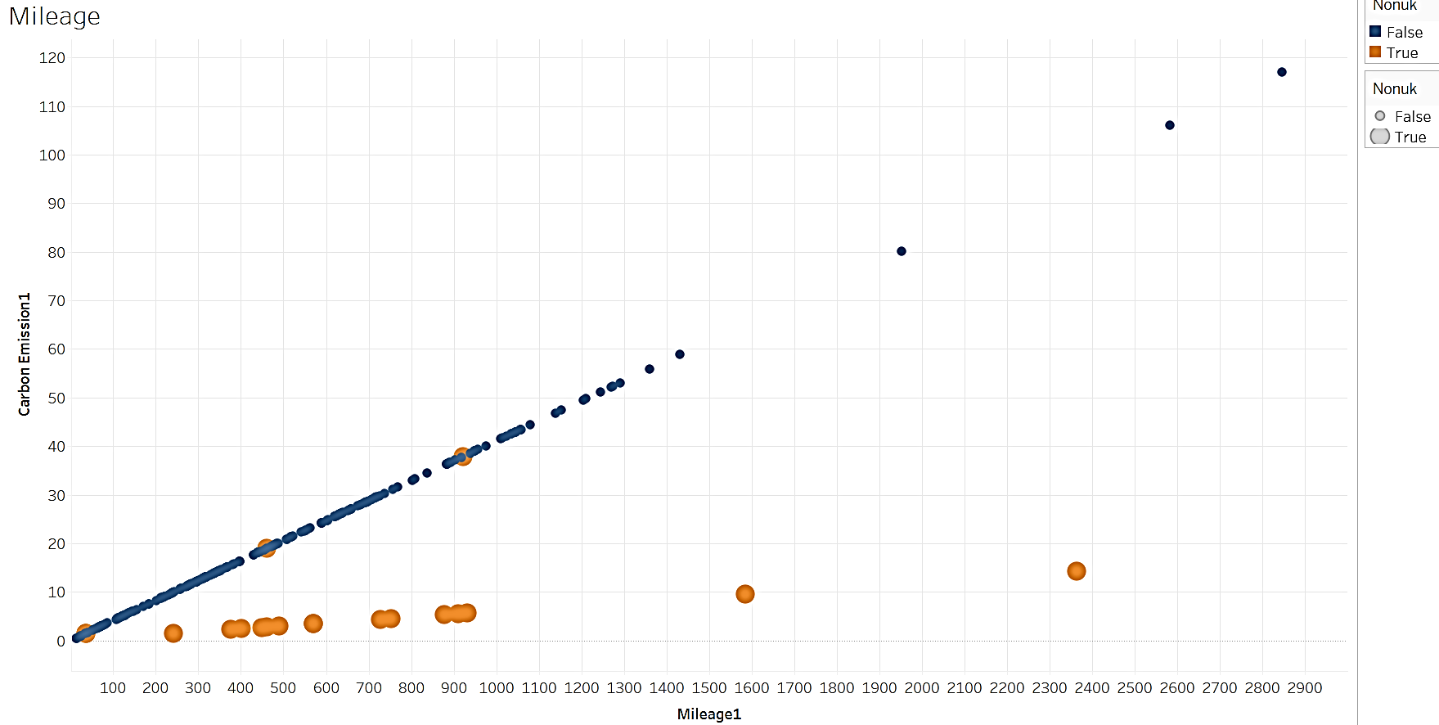
Variables that were most correlated with the CO2 emission
Carbon Footprint Assessment – Train Data​​
Use the data to calculate the CO2 per distance.
We end up getting around 0.0411/0.006 kg CO2 emissions per km on average.

Slide 12
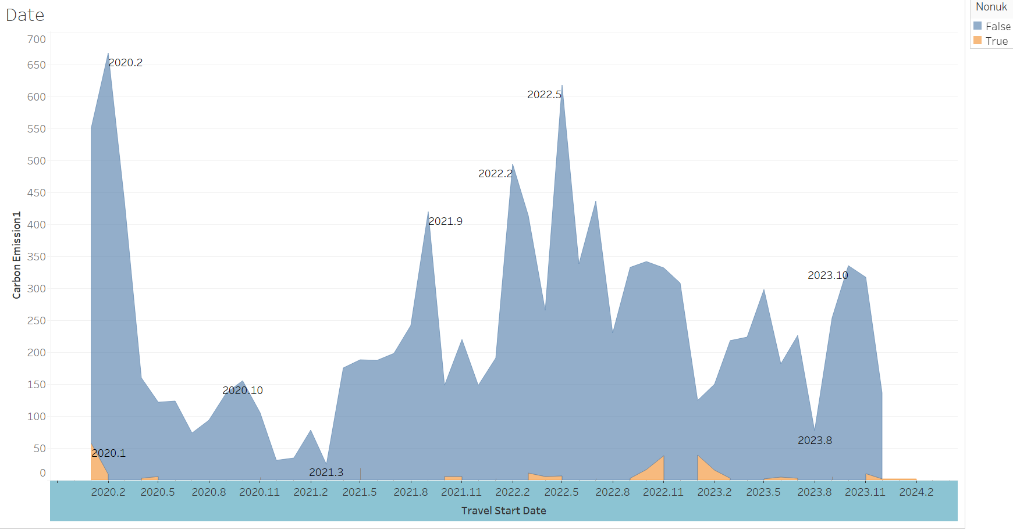
Carbon Footprint Assessment – Train Data​​
CO2 emission v/s Travel Date
Currently in a declining state, please prepare for the next railway peak.

Slide 13
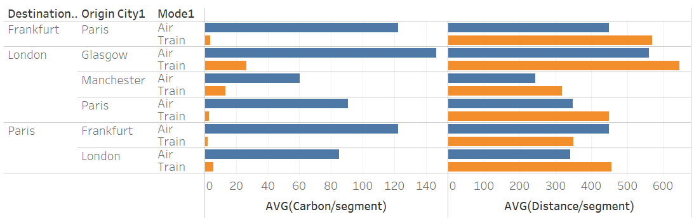
Optimisation of routes-Train​
COMPARISON TRAIN v.s. PLANE
CO2 emissions kg/km on average :
0.0411/0.006 (Train) v.s. 0.2233 (Plane)
Wider distribution of train stations (both urban and rural) v.s. airports

Slide 14
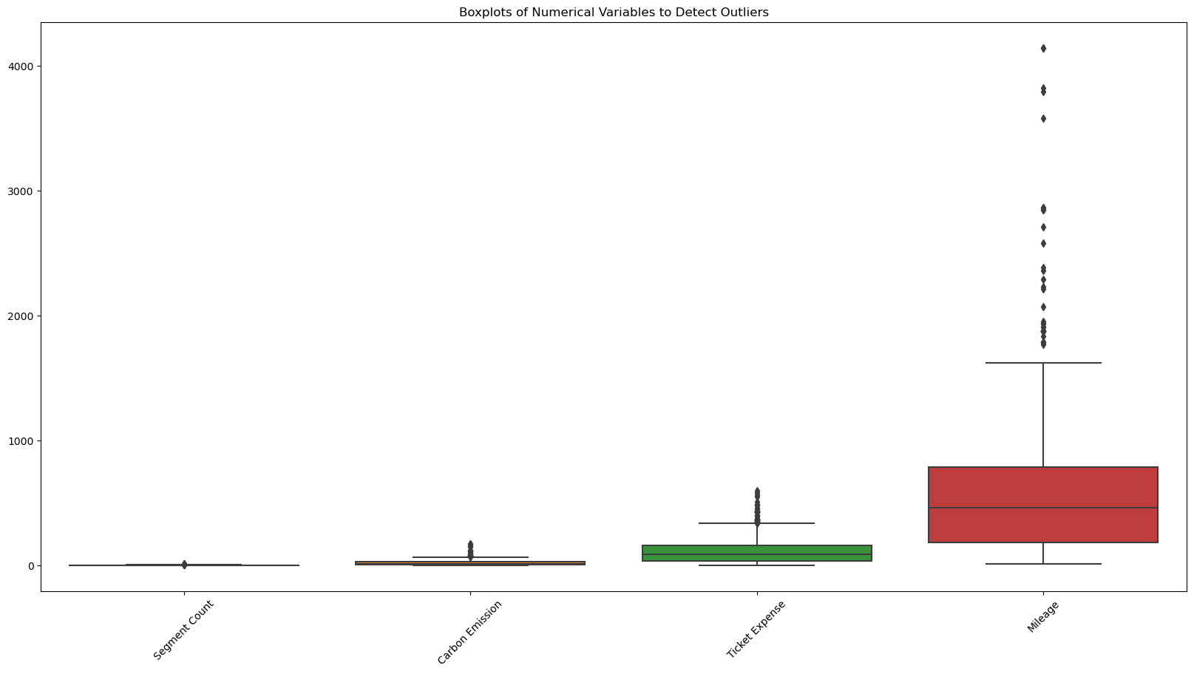
Data Preprocessing Stage
There are only 5 missing values in ’Employee ID’ and 3 missing values in ’Ticket Expense’. Drop the rows that have the missing values.
Some outliers can be found according to the box plot1.
’Segment Count’ means the number of tickets, and the outliers of ’Mileage’,’ Carbon Emission’, and ’Ticket Expense’ are attributed to the large number of ’Segment Count’

Slide 15
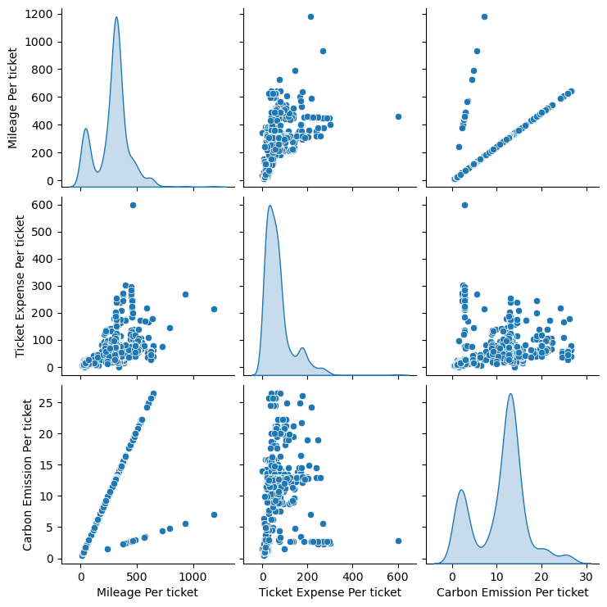
Exploratory Data Analysis
To deal with the outliers of the three columns, I created three more columns to reflect the individual mileage, carbon emission, and expense per ticket, which are 'Mileage Per ticket', 'Ticket Expense Per ticket', and 'Carbon Emission Per ticket’.
Notes:
1. The scatter plot of 'Mileage Per Ticket' and 'Carbon Emission Per Ticket' demonstrates two lines, which probably means the carbon emission is calculated by the mileage and there are two ratios for calculation.
2. It shows a strong relationship between 'Ticket Expense Per Ticket' and two other variables, which means as mileage increases, the expense also tends to increase.

Slide 16
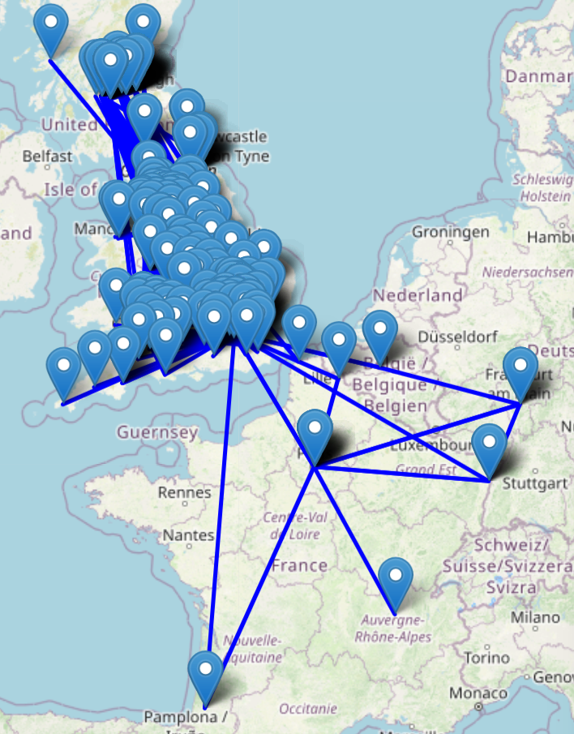
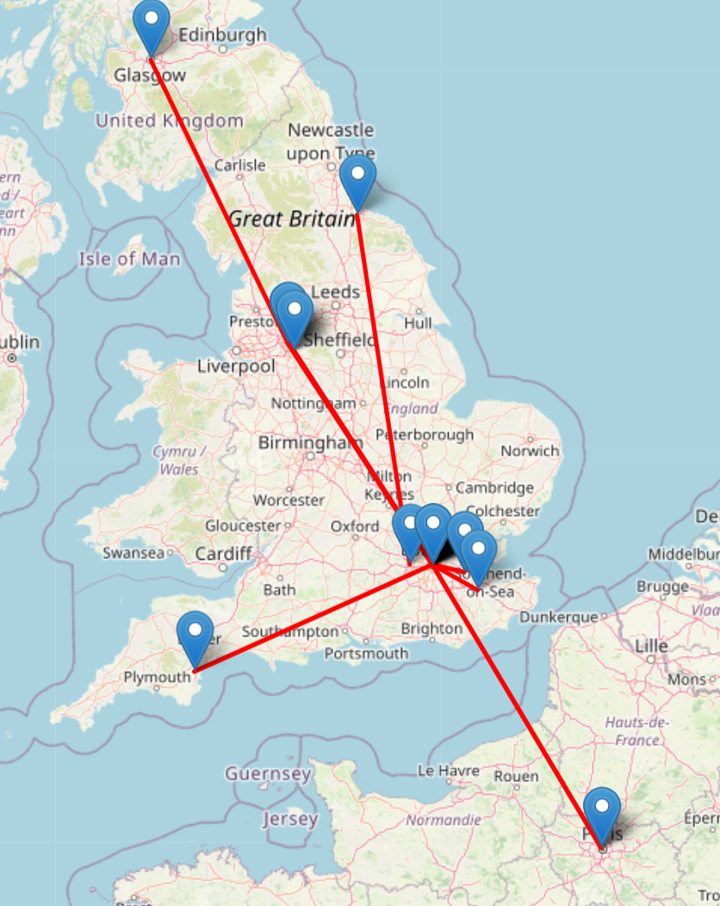
Traffic pattern analysis
Notes:
The first map demonstrates many routes within the UK and across nearby European countries. The dense clustering of markers means the majority of travel took place within the UK. It also includes the connections between the UK and its surrounding countries, such as France and Belgium, which means this company is an international company and does business with French companies.
The second map demonstrates the routes with higher travel times —— specifically those city routes with more than 10 tickets. It spotlights frequent travel between major cities, which is the London-Stockport route with 69 trips and 68 in the opposite direction. Other busy routes, such as Manchester to Glasgow and Newton Abbot to London, along with the international route from London to Paris, show the main domestic business connections and the international connection. By visualizing these significant routes, it will be easier to analyze the busiest routes for improving schedules, pricing, or the environmental impact.

Slide 17
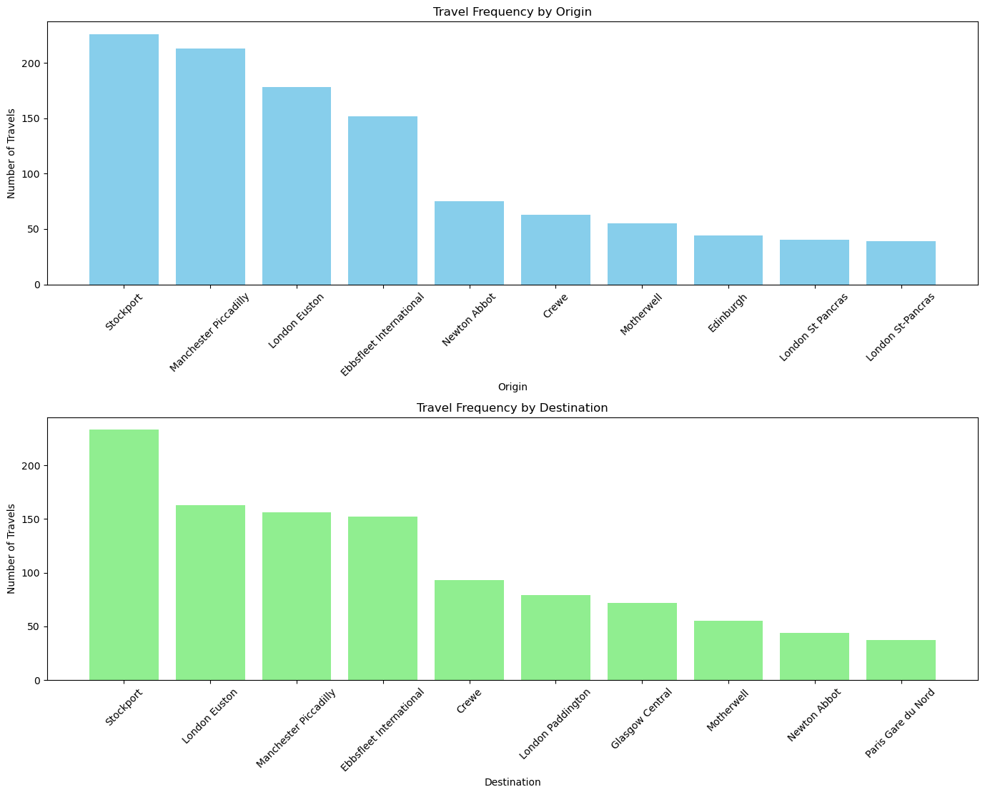
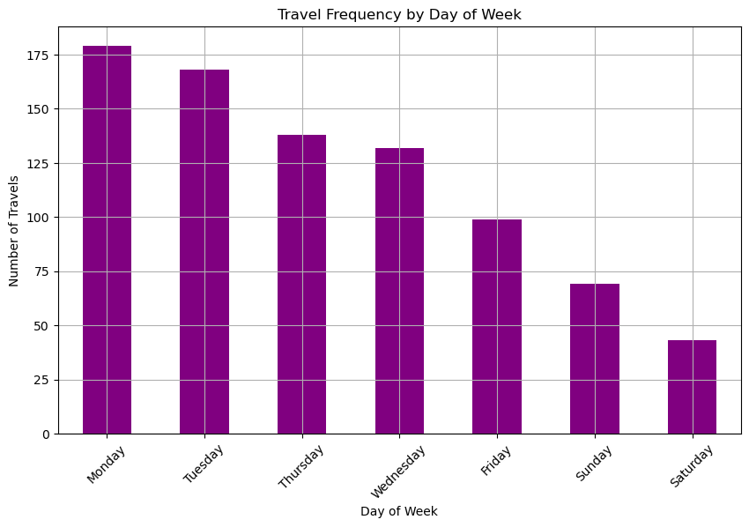
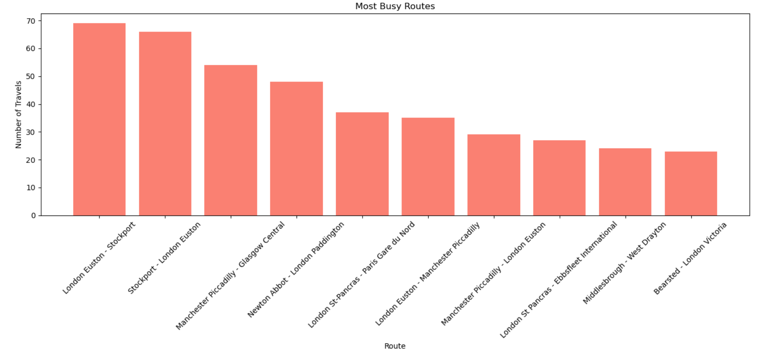
Travel Pattern
Notes:
179 trips took place on Monday which is the highest frequency, and it may reflect the fact that people tend to do long-distance business travel at the beginning of the work week.
Tuesday also shows second highest frequency with 168 trips.
Weekends(Saturday and Sunday) have significantly lower frequencies than weekdays with only 43 trips on Saturday and 69 trips on Sunday. It indicates that business trips are usually on weekdays and this situation can be improved by increasing more weekend travels if there are environment-friendly trips at weekends.
In terms of points of departure, I found that Stockport is the most common departure station with 226 journeys, followed by Manchester Piccadilly and London Euston with 213 and 178 trips respectively. It shows that we should focus on the trip with these departure points to reduce environmental impact. For destinations, it shows similar results with departure points.
By analyzing the busiest routes, it’s consistent with the above findings. The Stockport to Stockport route has the largest number of journeys(233), which means they bought return tickets. Except for the return tickets, London Euston - Stockport is the most frequent with 69 times.

Slide 18
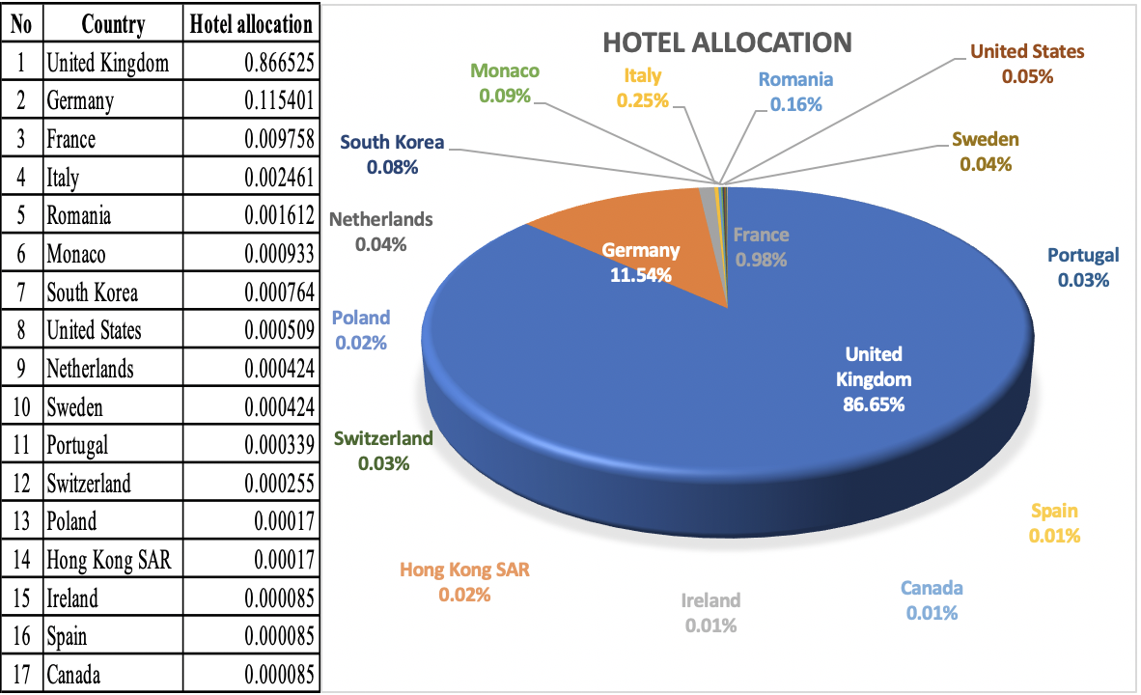
Analysis on Hotel Dataset Distribution of Main Market
Conversion factor as DEFRA (UK.GOV)

Slide 19
THE UK MARKET

Slide 20
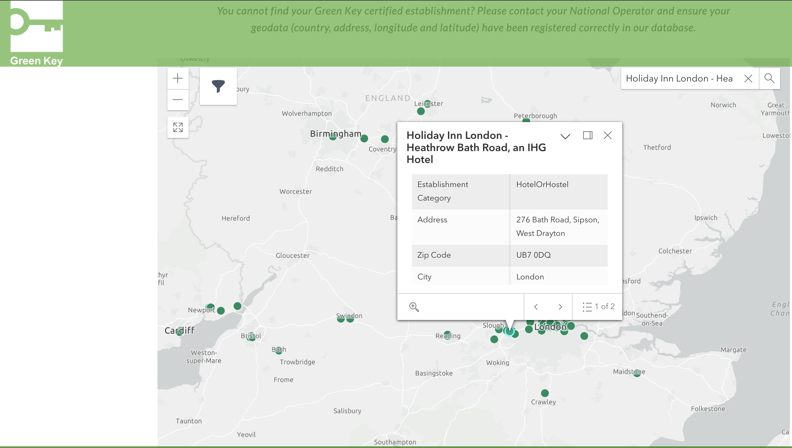
THE UK MARKET (CONTINUED)
Top - performing hotels

Slide 21
GERMANY MARKET
Top- performing hotels

Slide 22

FEEDBACK AND Q/A

